Slide 1


SAP UI5 & FIORI with OData TRAINING
Anubhav Oberoy & Shekhar Vedi
Day – 4

Slide 2

Agenda – Day 4
Introduction to jQuery
Introduction to NodeJS
Creating a server using NodeJS
Using external libraries in the Project
Under the hood of SAP UI5
Introduction to the MVC Architecture
Introduction to the SAP UI5 SDK
Creating our First UI5 Application

Slide 3

Introduction to jQuery
jQuery is a java script library, which is used to simplify our JS code.
It’s free to use
Used by top software companies like google, Netflix, etc.
Light weight JS library
jQuery greatly simplifies JavaScript programming.
Available on internet
Purpose is to write less and do more
Industry standard
How to use?
Download the jQuery library and keep it in our project, just like we use util/mycode.js
Reference jQuery from CDN (Content Distribution/Delivery Network) – directly reference it from internet
Syntax:-
$(selector).action();
Selector:-
tagName, .className, #id
$ - indicates browser that we willing to use jQuery
Selector – tell browser to target which are all the element(s)
Action – events, functions, special functions
Documentation of jQuery is available @ https://jquery.com

Slide 4

Exercise
In this exercise we will use jQuery to add some animations in our HTML page.
Exercise code/resource:
JSBasic.html
mycode.js
mystyle.css

Slide 5

Introduction to NodeJS
Node JS is an open-source, cross platform, JavaScript runtime environment and used to execute JavaScript on Server Side.
Node JS is a framework which allows us to run JS code outside browser. The main benefit is that a development do not need to learn multiple programming languages. If we know JS, we can code both client and server side in same language.
Node JS is also a great web framework for beginners because it works great for data intensive applications like streaming, gaming and real time apps. It leverage the power of JS’s Asynchronous no blocking IO.
Application of Node JS
Build Backend Application Logic
Host a Web Server (express)
Send Emails
DB lookup
Automation
Output to the user
Use its eco-system like PDF, EXCEL, EMAIL…
Install NodeJS in our system form here https://nodejs.org/en/, if you using bas, you do not need to install as BAS already has NodeJS preinstalled.
If we want to achieve something, this something was already achieved by someone, somewhere else in the world, they have already published it as a node module which we can import and reuse. We get ready-to-use code for consumption for speedy development. https://npmjs.com

Slide 6
Steps to create a Fresh NodeJS Project
Run a command called npm init – Create a new Nodejs project
Answer some simple questions like project name, starring file, author, version, description, …
We can mention the starring file of the project. We use myfirstnode.js as starring file, but in most of the cases we use index.js to follow the best practices.
We can just add some code to this file with all the modules
Then we run npm install module_name --save OR npm install module_name --save-dev to add a module to our project
To run the project, we can use the ‘node .’ command in the terminal.
npmjs
Steps to use an external library using node js
Find the library (module) of your purpose on npmjs and check its documentation
Use require statement
We have downloaded this library in local project – npm install MODULENAME
We need to add all the required module dependencies inside package.json file
We only ship our project to other developers/system
In the new system, we run npm install It will read all required modules and
Automatically download those dependencies.
npm install
Laptop
Project+
Module
Laptop
Project

Slide 7
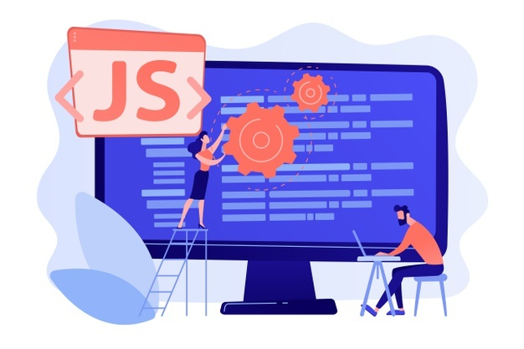
Exercise
In this exercise we will see how to create a server using the NodeJS.
We will try to get some date using the NodeJS server in the browser.
We will also integrate an html page with the NodeJS.
To initialize a NodeJS project we need to run npm init command in terminal.
Exercise code/resource:
myfirstnode.js
reuse.js

Slide 8
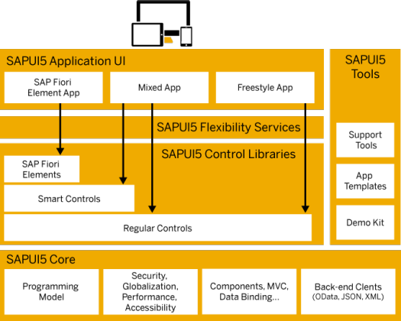
Under the Hood of SAP UI5
SAPUI5 simplifies web application development. A variety of UI controls, ranging from basic elements to complex UI patterns, can be combined for an appealing layout. All UI controls leverage a consistent design language and coherent UX patterns. SAPUI5 flexibility services let you easily adapt the UI of an app and store the changes in a layered repository.

Slide 9
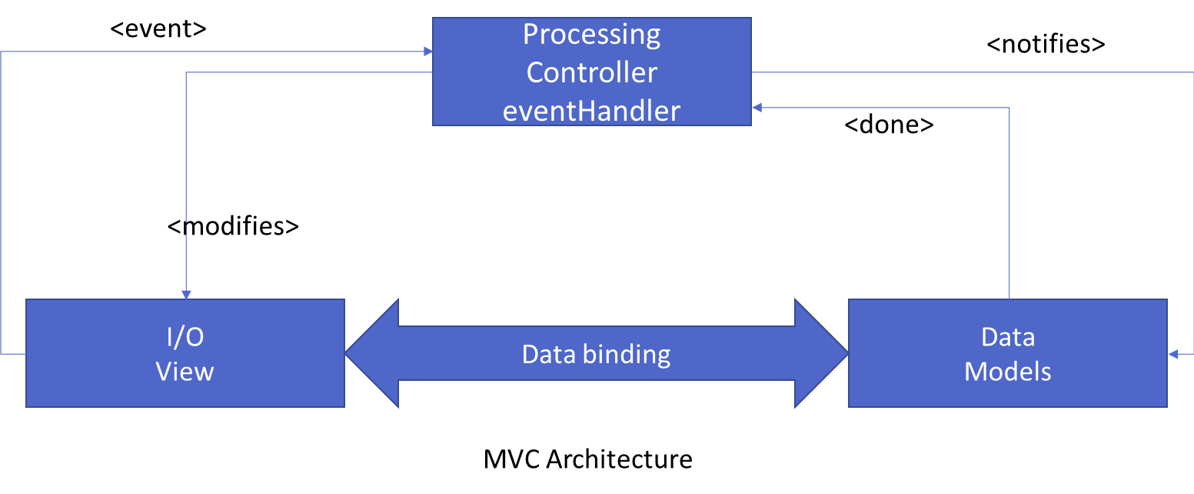
Introduction to MVC Architecture
MVC stands for Model, View, Controller.
Model:- The model component is a freely composed class that will keep the application data and do manipulations on it. All database accesses are done within the model.
View:- The View is responsible for defining the user interface to users. When a user sends a requests from his device, the view is responsible for data view as per the request submitted.
Controller:- The Controller is used to control the data and view events as per user interaction by updating the view and model.

Slide 10
Components of UI5 Application
The UI5 framework is built on top of open standards like HTML5, CSS, JS, and jQuery. We use MVC architecture to create applications using SAPUI5.
BAS
App
Developer
SAPUI5 Runtime Component
HTML+CSS+JS
sap.m
sap.ui.comp
sap.ui.table
sap.ui.layout
Renderer
sap.ui.core
sap.ui.unified
sap.ui.core.mvc
HTML5
CSS
JS
jQuery

Slide 11
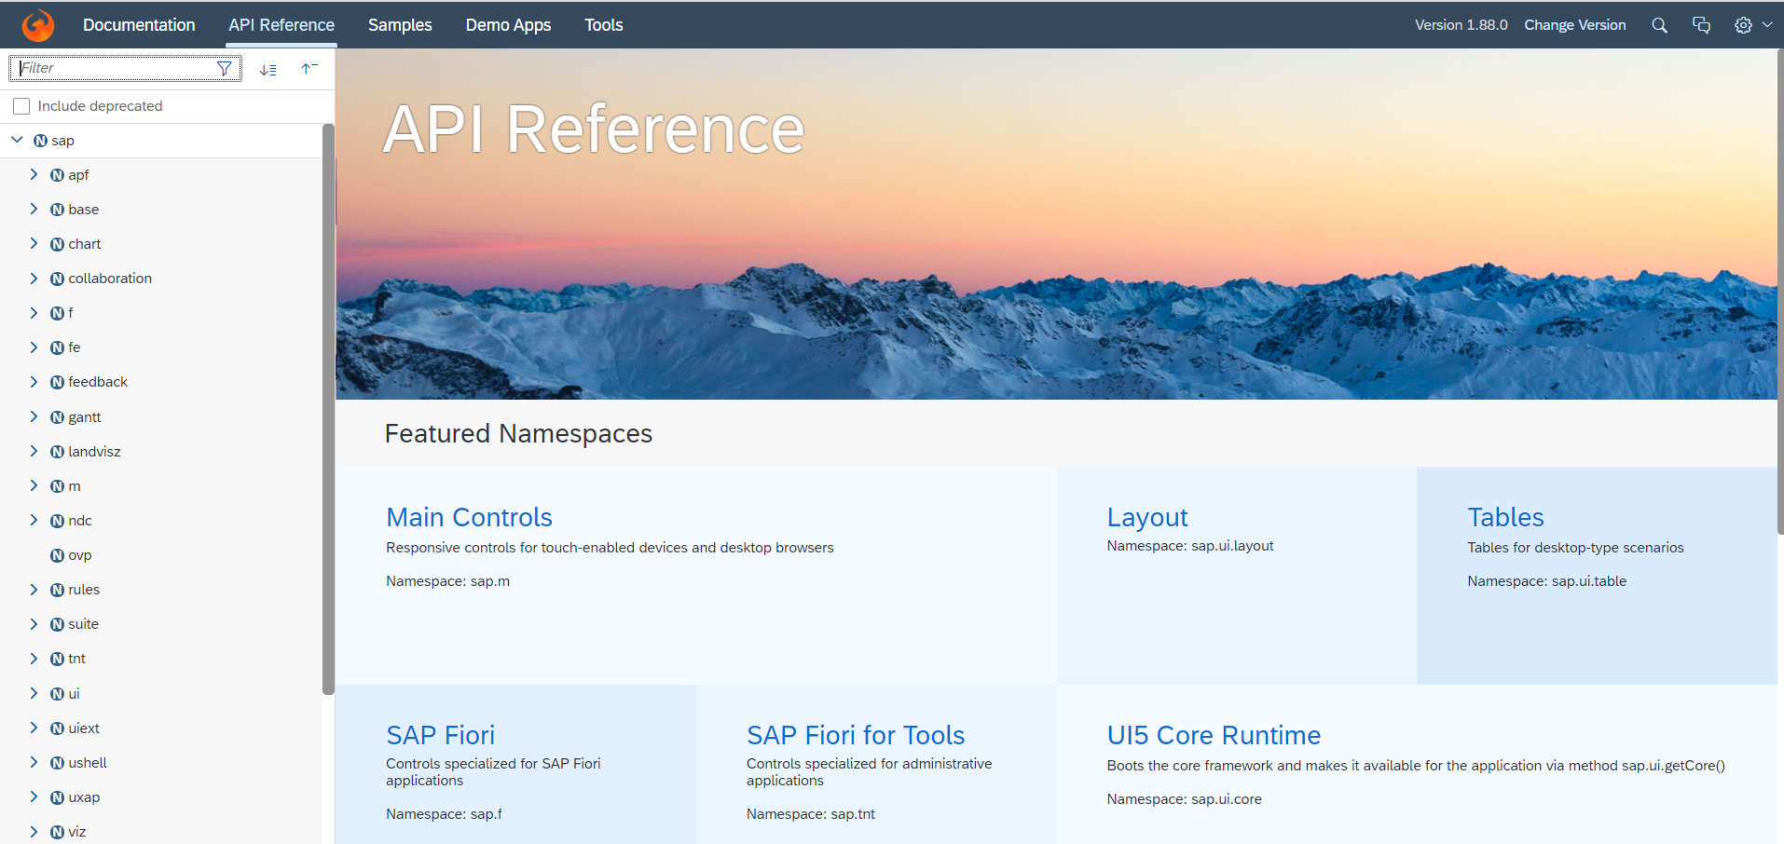
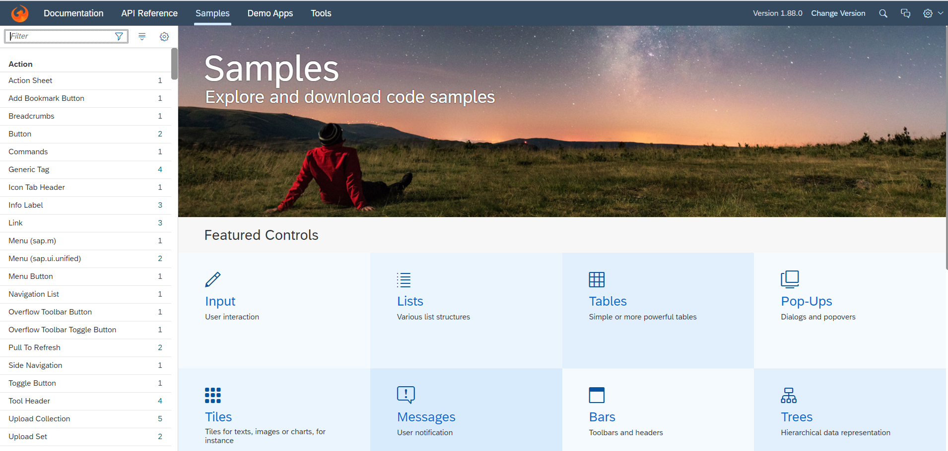
Introduction to UI5 SDK
Documentation of SAP UI5 is available at the SAPUI5 Software Development Kit.
We can access the SAP UI5 API’s at the Documentation page of SAP UI5 or you can use the link to go to sap’s API screen - LINK
We can directly search the required api’s on the SDK.
SDK contains the sample of all the controls which we can use in UI5
SAP UI5 API reference screen
SAP UI5 Sample reference screen

Slide 12
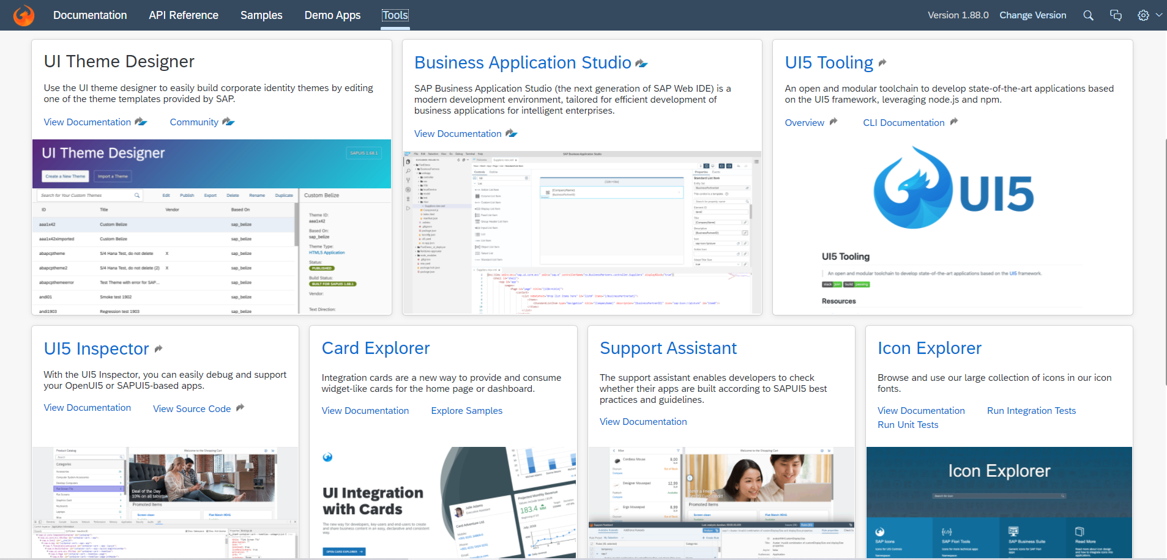
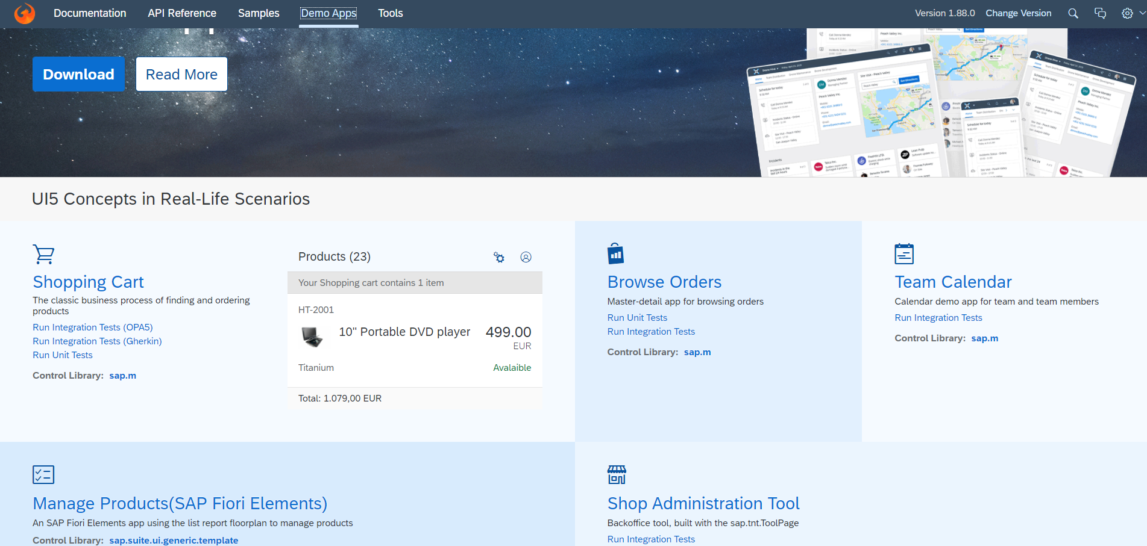
UI5 SDK continues…
UI5 SDK contains tools to make the development smooth for the developers.
It has UI5 icon packs which can be directly accessed for the UI5 SDK’s Tool Screen (Link).
SAP UI5 SDK provides us the demo application, So we can get an idea about how to create different type of applications using UI5 controls
UI5 SDK Tools Screen
UI5 SDK Demo Apps Screen

Slide 13
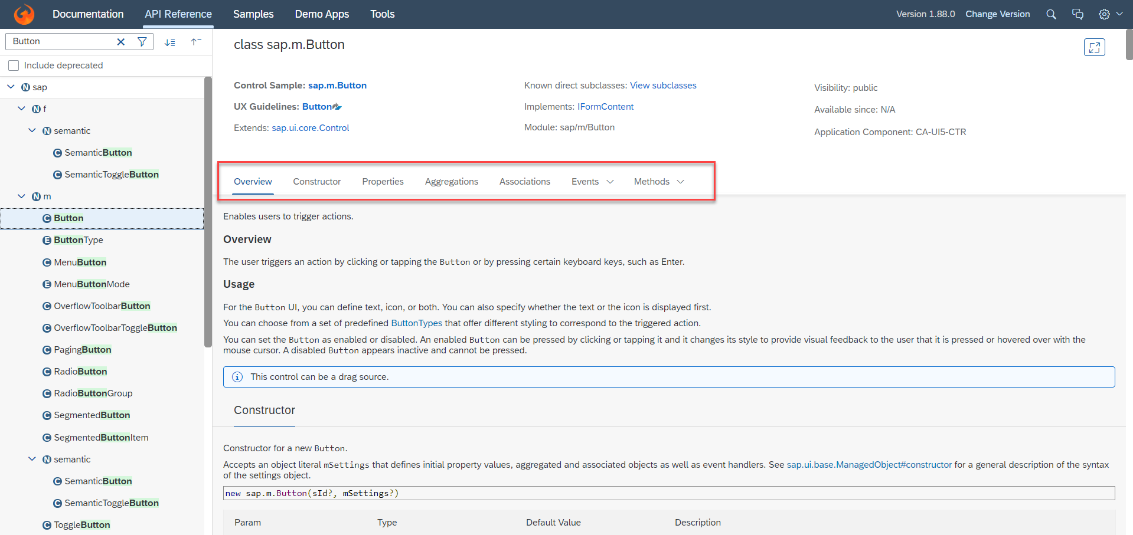
UI5 SDK continues…
When we search and open any API we see a screen similar to one which is shown below.
Every API contains different kind of:
Properties,
Aggregations,
Associations,
Events,
Methods

Slide 14

End of Day 4

Slide 15

Questions

Slide 16

Anubhav Oberoy

Slide 17


We’re committed to empower you to be
Most Desirable Resource
through powerful training solutions.
We build the workforce of the future.
250+
Corporate Clients
30,000+
Learners Trained
25000+
Learners Placed
FREE WEBINARS
Sign up for free webinars with industry experts every fortnight!
Enroll Now!
Contact us today!
https://anubhavtrainings.com/

Slide 18




More from AnubhavTrainings.com

Slide 19
Title
Content

